Slide 1
CAE Orientation for Consultants – Bentley V8i
CAE Support
CAE Support
January 2021

Slide 2
Overview
This presentation provides an overview of the Washington State Dept. of Transportation (WSDOT) Computer Aided Engineering (CAE) environment.
It is intended for consultants who are tasked with developing and delivering WSDOT project data using MicroStation and InRoads V8i.

Slide 3
Overview - What’s Covered
Introduction to WSDOT Computer Aided Engineering (CAE)
Supported Applications
Standards Manuals
Supporting Resources
Project Organization
File Naming Conventions
Element Conventions
Process Overviews
ProjectWise
WSDOT CAE Environment setup
Quick Tour
Getting Help

Slide 4
Intro to WSDOT CAE
The Computer Aided Engineering environment at WSDOT covers the following areas of work:
Field survey data processing
Design roadway geometrics analysis and engineering
Computer Aided Drafting (CAD) functions
Construction administration support
As-built deliverables
Engineering drawing\document management

Slide 5
Supported Applications
WSDOT currently accepts deliverables in the following formats:
Deliverable File Formats Bentley MicroStation V8i SS3 (v8.11.09.xx) and PowerInRoads V8i SS2 (v8.11.07.xx), are the official WSDOT drafting and design applications and versions. All deliverables to WSDOT shall be in the official version and produced using current CAE resources unless otherwise stated in a specific WSDOT-Consultant agreement. WSDOT is developing an environment for the Bentley Connect and platform anticipates piloting it (internal only) 2021. WSDOT IS NOT accepting any Connect platform deliverables at this time.
This information is published on our public web site:
www.wsdot.wa.gov/Design/CAE

Slide 6
Standards Manuals
WSDOT standards manuals applicable to CAE processes include (but are not limited to):
WSDOT Design Manual
(www.wsdot.wa.gov/Publications/Manuals/M22-01.htm)
WSDOT Plans Preparation Manual
(www.wsdot.wa.gov/Publications/Manuals/M22-31.htm)
WSDOT Electronic Engineering Data Standards Manual
(www.wsdot.wa.gov/Publications/Manuals/M3028.htm)
WSDOT Highway Surveying Manual
(www.wsdot.wa.gov/Publications/Manuals/M22-97.htm)
WSDOT Construction Manual
(www.wsdot.wa.gov/Publications/Manuals/M41-01.htm)

Slide 7
Supporting Resources
WSDOT CAE has developed a custom resource environment for CAE applications, including MicroStation, InRoads, and survey tools. This environment supports Agency deliverable requirements, and production dataflows to achieve them.
For V8i, this environment is powered by a central resource database that contains settings, attributes and parameters for all CAE applications. This ensures that the resources are synchronized and cross-referenced between applications. That database both generates foundational resource files, but also supports associated custom productivity tools.
Working units are US Survey Foot and Inches. Use provided seed files!
Project footprint data files (Base files) are in US Survey Foot. = PSE_Base.dgn
Sheet files may be in the following as determined by the WSDOT Project Office:
US Survey Foot for single-sheet per file and geographically correct sheets = PSE_Base.dgn
Inches for single- or multiple-sheet per file approaches = PSE_Sheet.dgn

Slide 8
Supporting Resources MicroStation
The CAE environment includes a comprehensive CAD element list in support of all WSDOT project deliverables development.
MicroStation is the foundation of the platform
WSDOT uses a user-friendly alpha based element and level naming convention.
The central database contains approximately 2400 CAD elements and assigns the appropriate attributes, cell (if applicable), and text characteristics to each.
All standard deliverable levels, lines styles, fonts, and cells are provided along with supporting base functional resources for printing and other processes.
WSDOT utilizes ByLevel attributes for all levels and for the most part, a 1-to-1 level to element approach.
Supporting DGN seed files are provided.

Slide 9
Supporting Resources InRoads
For InRoads
A comprehensive set of Feature-, Geometry-, Named-, and Survey- Symbology are included in the CAE environment via a centralized XIN template file.
Additional resources support WSDOT standards to each process in the InRoads workflow.
Agency standard survey field codes are processed into CAE element features via the XIN.
The environment also includes:
an InRoads Template Library (ITL) of typical components
Standards files for Stopping Sight Distance, Superelevations, and other process criteria per the WSDOT Design Manual.
Preferences to support various scaled plotting of Cross Sections.
A comprehensive report style sheet library.
And much more.

Slide 10
Project Organization
WSDOT projects are standardized and include:
A consistent folder structure
Repository for project-specific resources
Cells and other resource files unique to the project that are generated by the project staff in complement to the Agency standards.
Discipline-specific workspaces
The deliverable requirements for each discipline
Defined in the WSDOT Electronic Engineering Data Standards (EEDS) Manual, Deliverables 3 Project Directory Structure and Deliverables 8 ProjectWise.
www.wsdot.wa.gov/Publications/Manuals/M3028.htm

Slide 11
File Naming Conventions
Standardized file naming conventions provide uniformity in structure and greater ease when searching for data, and stable performance.
Keep file names to minimum practical length
Do not use special characters in folder or file names
WSDOT applies standard naming conventions for each discipline. For example:
CAD\Plans Production (MicroStation) files
[PlanSheetNumber]_Work Order_FileType_PlanType_PlanRefNumber
00025_XL1234_PS_AL_003.DGN
This is sheet AL3 which is sheet 25 in the overall contract plan set.
See the EEDS Manual, Deliverables 4 File Naming Conventions.
www.wsdot.wa.gov/Publications/Manuals/M3028.htm
See WSDOT CAE Tech Notes (www.wsdot.wa.gov/design/cae/technotes.htm)
CAE Standards Quick Reference Guide (wa.gov)
See Microsoft guidance on path and file naming convention limitations in Windows
https://docs.microsoft.com/en-us/windows/win32/fileio/naming-a-file

Slide 12
Element Naming Conventions
WSDOT uses an environment-wide standard element naming convention for drafting and engineering elements.
Survey uses short codes for efficient field data collection that get translated to the engineering convention via InRoads survey data processing.
See Field Code Report - By Code (wa.gov)
WSDOT uses a Major (Parent) _ Minor (Child) _ Element approach
Parent Category = Drainage (DR)
Child Category = Structures (ST)
Element = CatchBasin
See WSDOT CAE Standards Quick Reference Guide (wa.gov)
DR_ST_CatchBasin

Slide 13
Process Overview
Survey [InRoads for processing]
Field Survey
Cadastral & Right-of-Way Data
Surface *.DTM
Geometry *.ALG
Design [InRoads]
Roadway Modeler
Drafting [MicroStation]
Baseplan Development
Quantities Extraction
Quantities Extraction
Archive Final Project Data
PS&E Plan Generation
Construction [InRoads & MicroStation]
Construction Administration
As-Built Documentation

Slide 14
Process Overview
Field Code
Field Survey
survey_wsdot.fwf
wsdot_standards.xin
Feature Style
Geometry Style
InRoads Design
Named Symbology
wsdot_standards.xin
Level Name
MicroStation Drafting
WSDOT.DGNLib
WAE*.cel
LStyles.rsc
Cell Name
Color
Weight
Linestyle

Slide 15
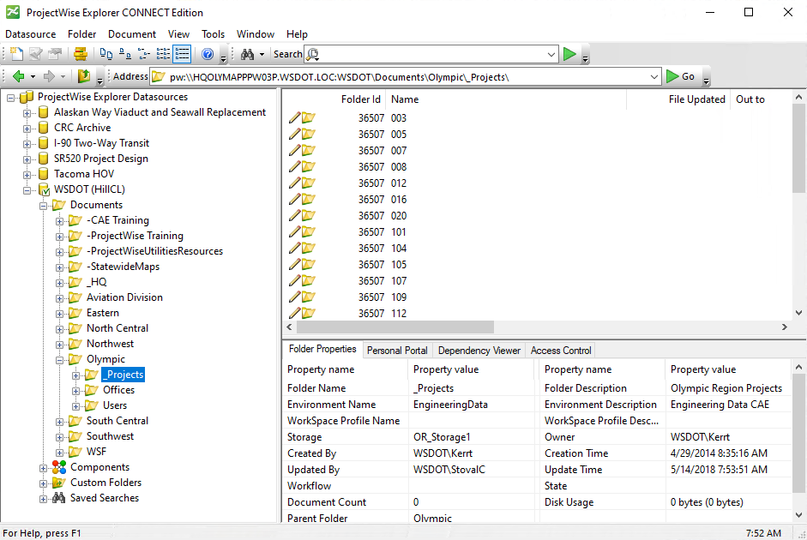
ProjectWise
ProjectWise is a project collaboration and architecture, engineering, construction, (AEC) information management software.
It allows full collaboration between workgroups made up of staff both internal and external to WSDOT.
ProjectWise uses a folder\document structure similar to Windows Explorer.
Contact WSDOT CAE Support for access and support.

Slide 16
WSDOT CAE Environment Setup
Step 1 – Download the WSDOT V8i resource WinZIP
Computer Aided Engineering - Resource Updates | WSDOT (wa.gov)
WSDOT CAE installation instructions (wa.gov)
Step 2 – Extract the resource set to a central location
Step 3 – Create a shortcut with the appropriate switch content.
“Application EXE” –wsWSDOT_Resources=[central location/]
Add WSDOT.cfg file to workstation Application Install structure
Test shortcut.
You should see

Slide 17
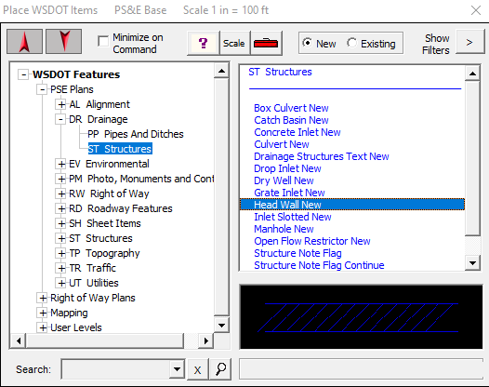
Quick Tour
WSDOT custom tools are accessed from the WSDOT pull down.
Place WSDOT Items
Driven by our central database
Set drawing Scale
Browse through standard categories and lists
Pick an element
Double-click to place
Search for elements

Slide 18
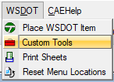
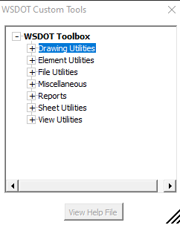
Quick Tour
WSDOT custom tools are accessed from the WSDOT pull down.
Custom Tools
Browse through categories of custom tools
Double-click to activate
Click once to enable the View Help File button for instructions.

Slide 19
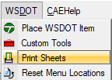
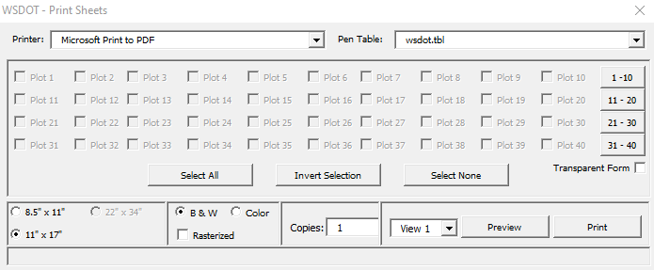
Quick Tour
WSDOT custom tools are accessed from the WSDOT pull down.
Print Sheets
Exclusive to PSE_Sheet seed based files
Specific to historic WSDOT custom 40 sheet border per file approach.
Relies on Place\ Label sheet utility in Custom Tools > Sheet Utilities
Contact your WSDOT Project Office for sheet method require- ments.

Slide 20
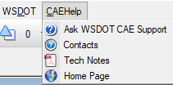
Quick Tour
CAEHelp provides resources to get more info down.
Ask WSDOT CAE Support – sends quick question to WSDOT HQ CAE Help Desk
Contacts – quick link to our contacts website
Tech Notes – links to our library of tech notes and process instructions
Home Page – links to our main external home page

Slide 21
Getting Help
Computer Aided Engineering - Support | WSDOT (wa.gov)
(www.wsdot.wa.gov/Design/CAE)
WSDOT Statewide CAE Help Desk hqcaehelpdesk@wsdot.wa.gov
Keith Anderson – Help Desk Supervisor
Aaron Cleveland – ProjectWise Admin
Mike Garcia – CAE Support Engineer
Jeff Graham – Survey Support
Clint Hill – CAE Support Manager
Regional CAE Support Staff
James An – Northwest Region
Andy Hash – Northwest Region
Phil Walker – Southwest Region
Mark Morin– State Ferries
Emailing the CAE Help Desk is the best option as all staff are teleworking

